Slide 1
End of the Universe

Slide 2
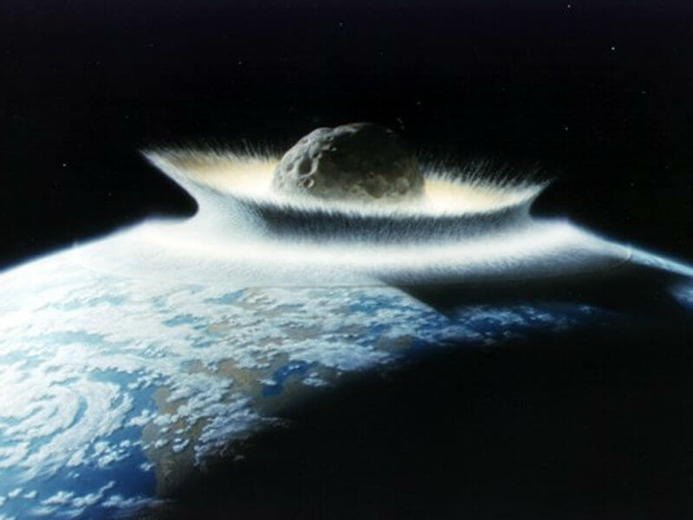
By the end of this lesson, you should be able to:
Explain how we know that the universe is accelerating its expansion.
Discuss the various theories on how the universe might end.

Slide 3
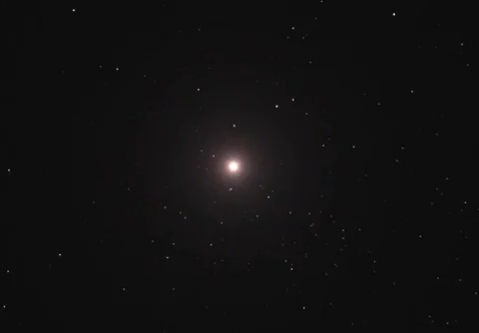
In 1994 a scientific team was formed to measure the expected deceleration (slowing down) of the universe's expansion.
This team was called the High-Z Supernova Search Team (HZT), and their leader was Australian astrophysicist Brian Schmidt.
The HZT used images from telescopes around the world, as well as the Hubble Space Telescope, to measure the properties of distant supernovas.

Slide 4
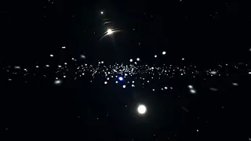
The data that the HZT found was unusual. Contrary to known theories, the universe's expansion was actually accelerating.
Schmidt spent six weeks checking the experiment for a mistake, but the implications of their data were clear. Redshift data of these ancient supernovae showed that they are accelerating away from our galaxy.

Slide 5
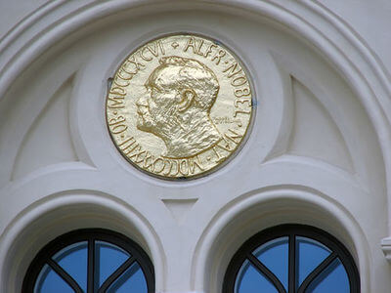
Brian Schmidt published a paper on this data in 1998, along with fellow HZT member Adam Riess.
This result was also discovered near-simultaneously by the Supernova Cosmology Project (lead by Saul Perlmutter).
The work of all three men was recognised in 2011 when they were jointly awarded the Nobel Prize in Physics.

Slide 6
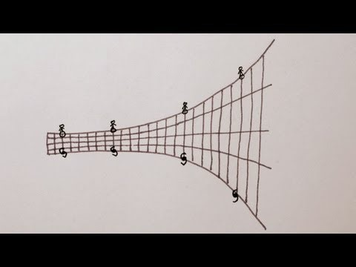

Slide 7
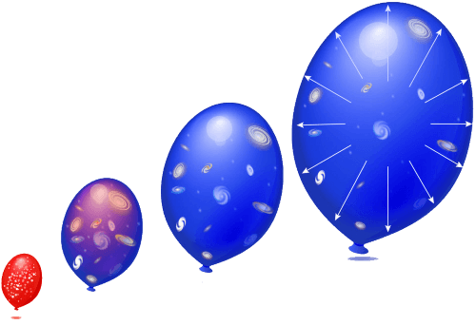
You can do an experiment to visualise this idea.
Take an uninflated balloon and use a marker to cover it with dots, and then blow it up. See how the dots get further and further apart without moving?
The space between each dot is expanding in two dimensions. The same thing is happening to the universe. All three dimensions of space are expanding and this pushes galaxies away from each other.
The reason for this is not yet understood. Scientists call the energy behind the acceleration "dark energy".

Slide 8
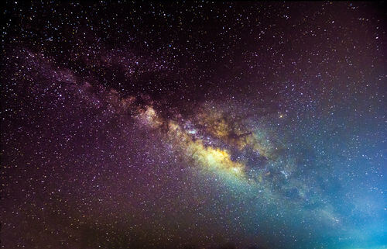
Some close galaxies are in fact moving towards the Milky Way.
Two forces act on these galaxies - the force of universal expansion and the force of gravity. For some galaxies, gravity is actually stronger than universal expansion - so they move towards other galaxies.
This is happening to the Andromeda and Milky Way galaxies - gravity is stronger than universal expansion, so the galaxies are moving towards each other.

Slide 9
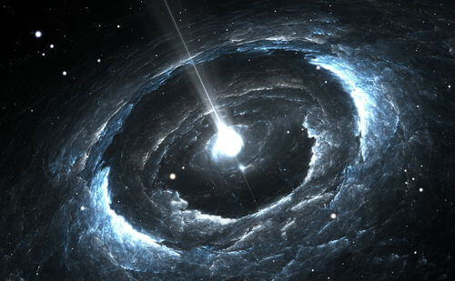
The ever-increasing rate of expansion of the universe is not yet well understood.
It appears that there is a repulsive force that is making the universe grow ever more quickly.
It is hypothesised that this is caused by an unknown form of energy called dark energy. Dark energy makes up around 68% of the universe's total energy.
We call it "dark" energy not because it has a colour, but because it is unknown - scientists know almost nothing about dark energy.

Slide 10
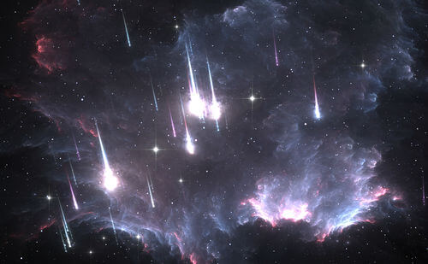
Another unknown, hypothesised phenomenon is dark matter.
Most galaxies appear to contain far less mass than they actually do. We can measure this by comparing their predicted movements to their actual movements under gravity.
The hypothesised explanation is that an unknown type of matter is spread throughout the universe that is undetectable. It does not interact with light, so it appears invisible - we can only detect it through interactions with gravity.
Therefore, we call it "dark matter".

Slide 11
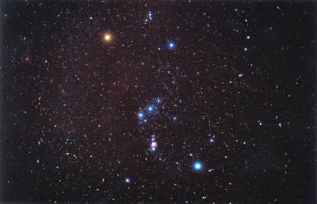
The fact remains that we are unsure why the universe is accelerating - all that is known is that dark energy is making it happen.
The consequence of this is that distant galaxies will have their light redshifted more and more as they approach the speed of light.
Eventually, we will stop receiving light from these galaxies. One by one, they will disappear from view.

Slide 12
“The story so far:
In the beginning the Universe was created.
This has made a lot of people very angry and been widely regarded as a bad move.”
- Douglas Adams, The Restaurant at the End of the Universe

Slide 13
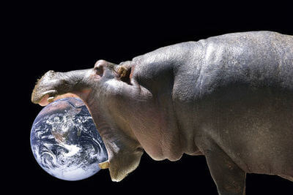
The expansion of the universe raises an interesting question - will it ever stop?
And on that note, will the universe ever stop?
Current scientific knowledge says yes, although there is some disagreement as to how this will occur.
Let's take a look at the most likely future of the universe. Warning: it's not going to be pretty.

Slide 14
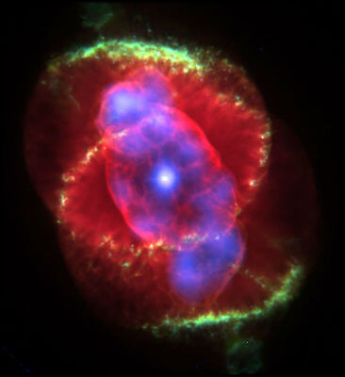
In about 5 billion years, the Earth as we know it will end.
The Sun, running out of fuel, will become a red giant. This process will cause it to grow so large that Mercury, Venus and the Earth will all be engulfed.
Humanity will be extinct or will have moved beyond the solar system by this point.
Eventually, this red giant Sun will also die - most of its mass will be expelled as a planetary nebula, while a white dwarf will be left behind.

Slide 15
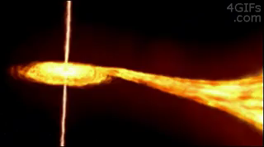
Many more stars in the universe will meet the same fate, while others will explode in supernovas that leave behind neutron stars and black holes.
New stars are created by gravity drawing planetary nebulas and the debris from supernovas together.
Over time, the fuel for star formation is being left behind inside the stellar remnants - white dwarfs, neutron stars and black holes.
Eventually, the universe will run out of material to make new stars out of.

Slide 16
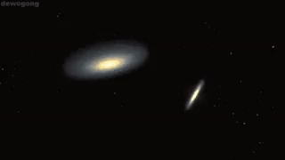
The closest galaxy to the Milky Way is the Andromeda galaxy - and unlike most galaxies, it is currently travelling towards us.
In about 5 billion years, the Andromeda galaxy will collide with the Milky Way - current research from the Hubble Space Telescope indicates that this is almost certain to happen.
Both galaxies will merge into one large galaxy currently nicknamed Milkomeda - it is likely that the Sun will be ejected from the galaxy during this event.

Slide 17
The local group is a cluster of galaxies near the Milky Way that are gravitationally bound to each other.
All of these galaxies and star clusters will eventually collapse into each other following the Andromeda collision.
Between 100 billion and 1 trillion years from now, the entire local group will have merged into one galaxy.

Slide 18
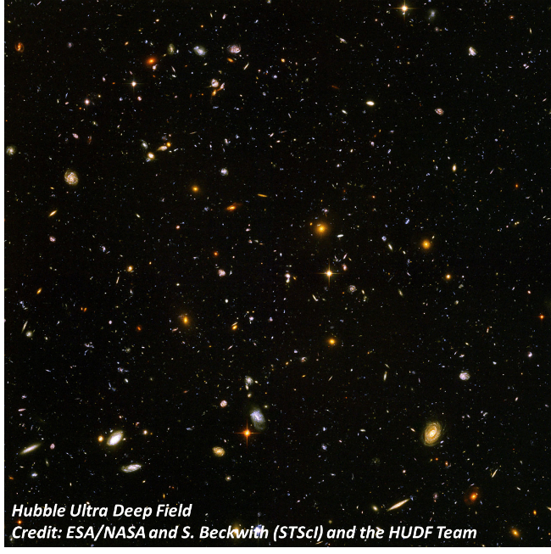
In 150 billion years, the galaxies outside the local group will pass beyond a point called the cosmological horizon.
Their relative speed to the local group will be so high that it becomes impossible for events in the local group to affect events in the distant galaxies, and vice versa.
Time in the other galaxies will appear to stop. Intergalactic travel and communication will become impossible after the cosmological horizon is reached.

Slide 19
The light from the distant galaxies will slowly fade away, until the local group is seemingly alone in the universe.
The local group will still contain trillions of stars and star systems, and will continue to produce new stars for the next 100 trillion years. After this point, star formation will end and the Degenerate Era will begin.
Every remaining star in the universe will live out its lifespan before dying and forming white dwarfs, neutron stars and black holes.

Slide 20
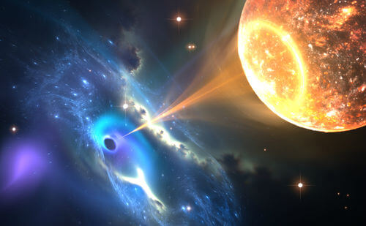
The death of the last star will extinguish most light in the universe.
Stellar remnants will begin to be either ejected from collapsing galaxies or pulled into black holes.
The elements decay as they reach the end of their natural life spans and begin to cascade down the periodic table into hydrogen.

Slide 21
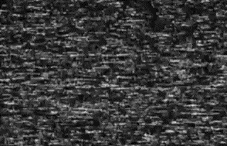
Gravity will collect the mass of the universe into black holes
These supermassive black holes will dominate the universe after 1040 years.
Eventually the black holes will also evaporate, and all matter will decay into the smallest possible particles. The energy of the universe has fallen to almost nothing.
And then, finally, the universe will end.

Slide 22

The mysterious nature of the universe means that its fate is ultimately unknown.
Scientists are still able to theorise the universe's ultimate fate by calculating the possible outcomes of the universe's expansion, based on known data.
Three possible fates include: the Big Freeze, the Big Rip and the Big Crunch. None of which sound pleasant at all.

Slide 23

The Big Freeze happens if the universe continues to grow and expand at the same accelerated rate forever.
All energy and matter begins to separate and settle into a uniform distribution across the universe. The temperature of the universe becomes absolute zero, and all action stops.
The end result of the Big Freeze is a still, empty universe that continually expands. At this stage, it is very unlikely that anything else will ever happen again.
This is known as the heat death of the universe.

Slide 24

A spark of creation in a frozen wasteland:
Some interpretations of the Big Freeze model note that fluctuations in the frozen universe could allow for the spontaneous generation of a new Big Bang (or several).
From nothing would come something - a new universe, similar to our own.
If this is indeed possible, it may give an explanation for our own universe's Big Bang. We could exist in a series of ever-larger universes, like a set of matryoshka dolls.

Slide 25

An alternative to the Big Freeze is the Big Rip.
If the universe has enough dark energy, then it is possible that the rate of universal acceleration will actually increase over time.
(Fun fact: The rate of change of acceleration is known as "jerk"! It has units of m/s3).
If the universe has a positive jerk, then expansion will become too fast for any matter to stay together.
The universe will tear itself apart into the most basic particles possible, and in the final moments of the universe space-time itself will fall apart as the expansion rate becomes infinite.

Slide 26
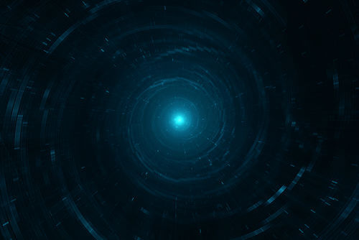
A more unlikely scenario is the Big Crunch.
A possible slow-down of the universe's expansion could cause it to ultimately contract. This would start to push everything in the universe together.
The contraction would happen over the same timeframe as the universe's expansion. Eventually, all matter in the universe would be pushed together into a singularity in a reversal of the Big Bang.

Slide 27
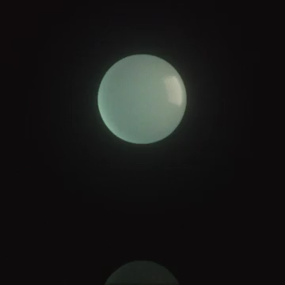
The Big Bounce theory is based on the idea that the singularity created by the Big Crunch can then re-explode into a new universe.
This creates a cycle of creation and destruction, where one Big Crunch leads to a new Big Bang. This cycle would likely carry on indefinitely.

Slide 28

Finally, an idealised theory is that of the Steady State.
This assumes that dark energy and gravity will eventually reach equilibrium.
(There is a theory on the origins of the universe also called the Steady State theory. They are similar but are about different things).
In this case, the universe reaches a maximum size and then stops expanding.
Steady State is an attractive option, as it means that life as we know it can carry on for an infinite time. However, it is also very unlikely to occur based on our current knowledge of the universe

Slide 29
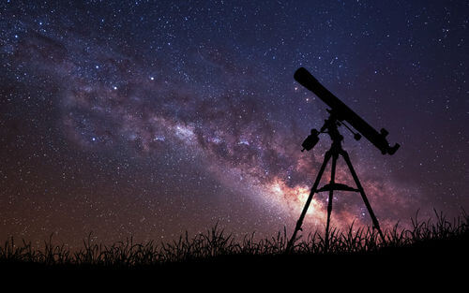
Because the physics of dark energy is currently unknown, there exists a high degree of uncertainty about any theory that predicts the future.
As our knowledge of the universe increases, so too will our knowledge of future events.
All that scientists can do is make hypotheses based on their current knowledge of the universe, and simply revise these predictions if new information comes to light - as is the case with every area of science.

